Slide 1

Project#1
-Ayush Manojkumar Lodha
Under Guidance of Prof. Shiaofen Fang
Course : CSCI 55200: Data Visualization

Slide 2
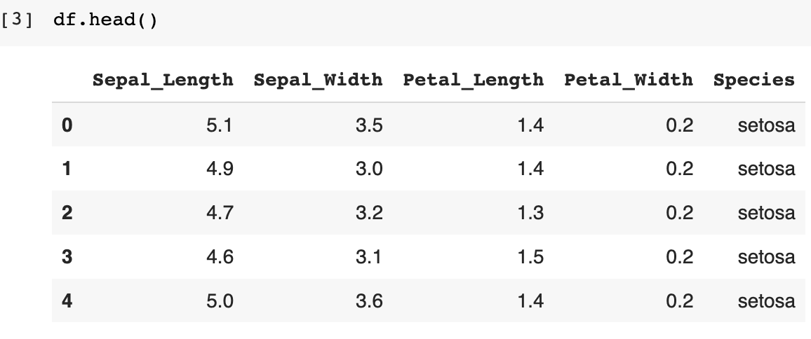
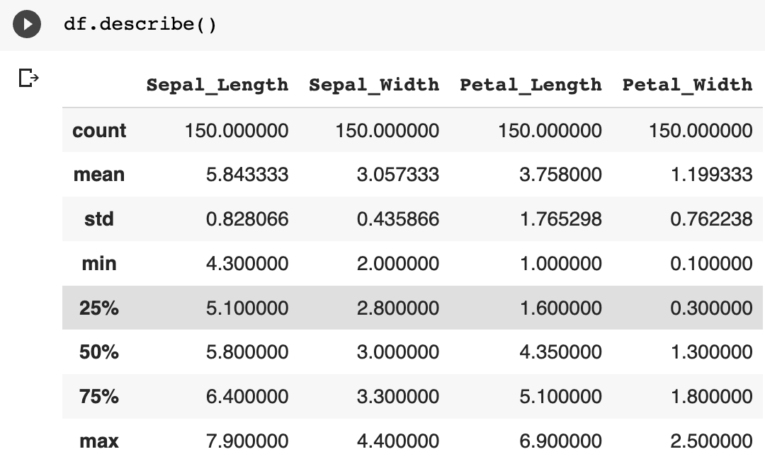
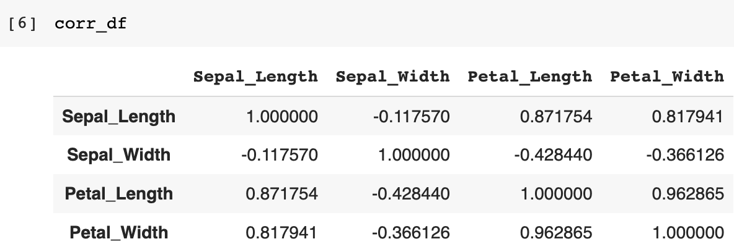
Iris.csv [Description]
Iris Dataset has 5 columns and 150 rows, and the description of the data is as follows:

Slide 3
Multibar Grouped Chart
Visualization#1

Slide 4
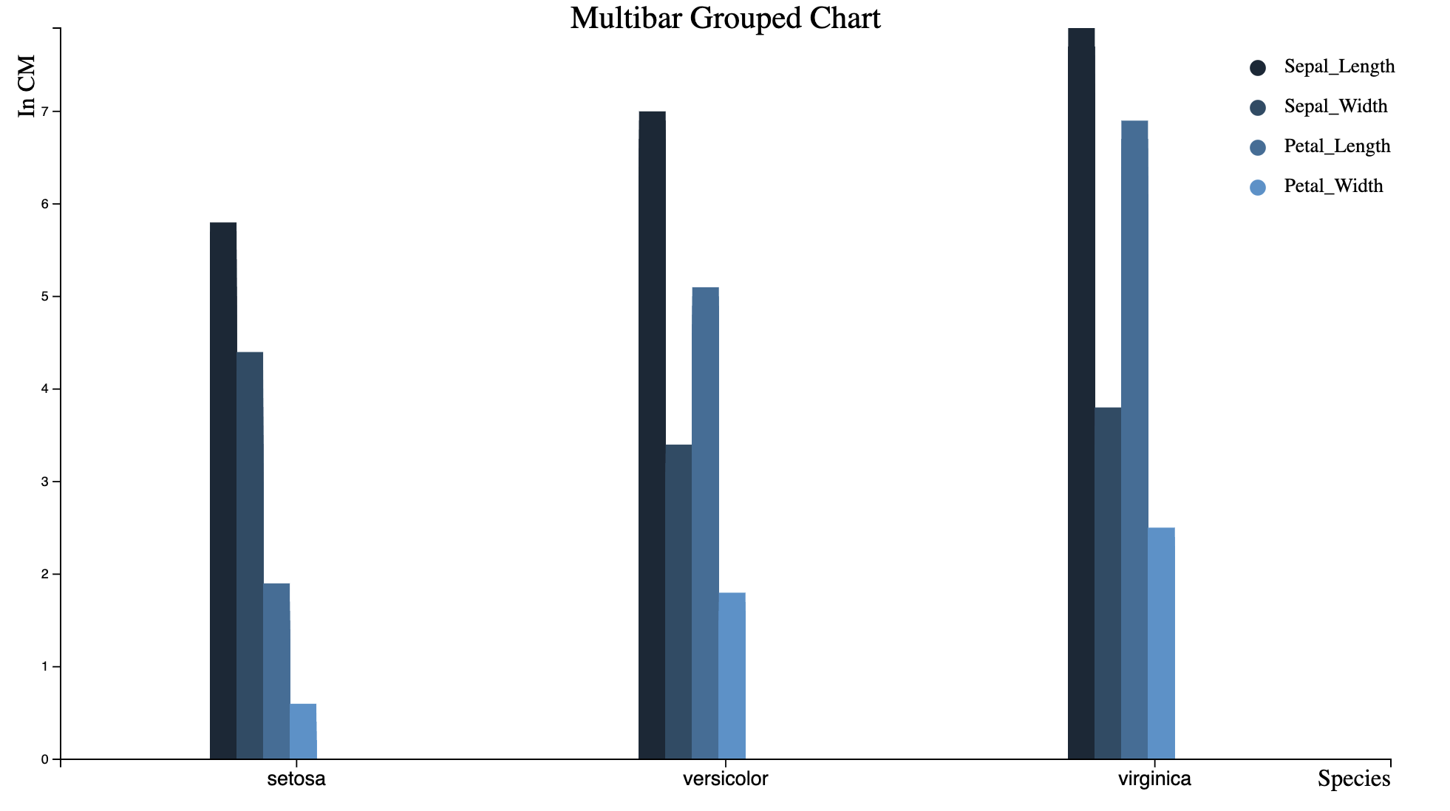
Multibar Grouped Chart
Source HTML file: Multibar_Grouped_Chart.html

Slide 5
Scatter Plot Matrix
Visualization#2

Slide 6
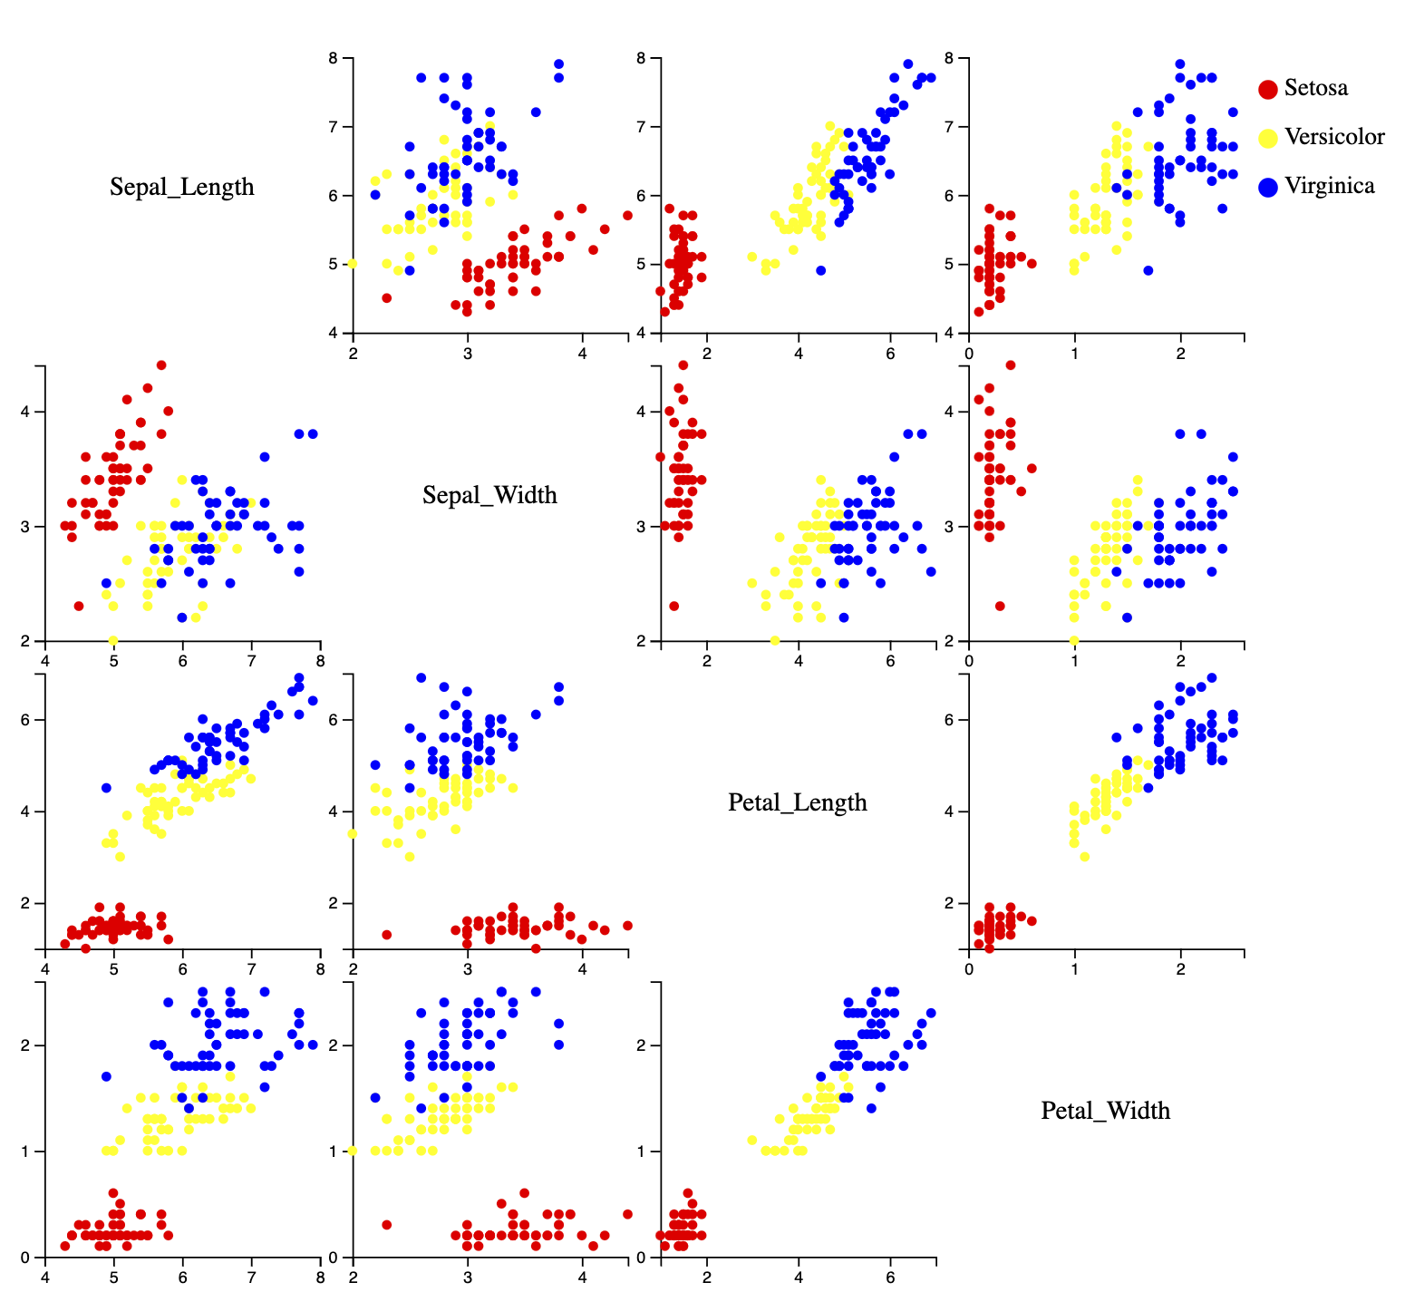
Scatter Plot Matrix
Source HTML file: Scatter_Plot_Matrix.html

Slide 7
Correlation Matrix
Visualization#3

Slide 8
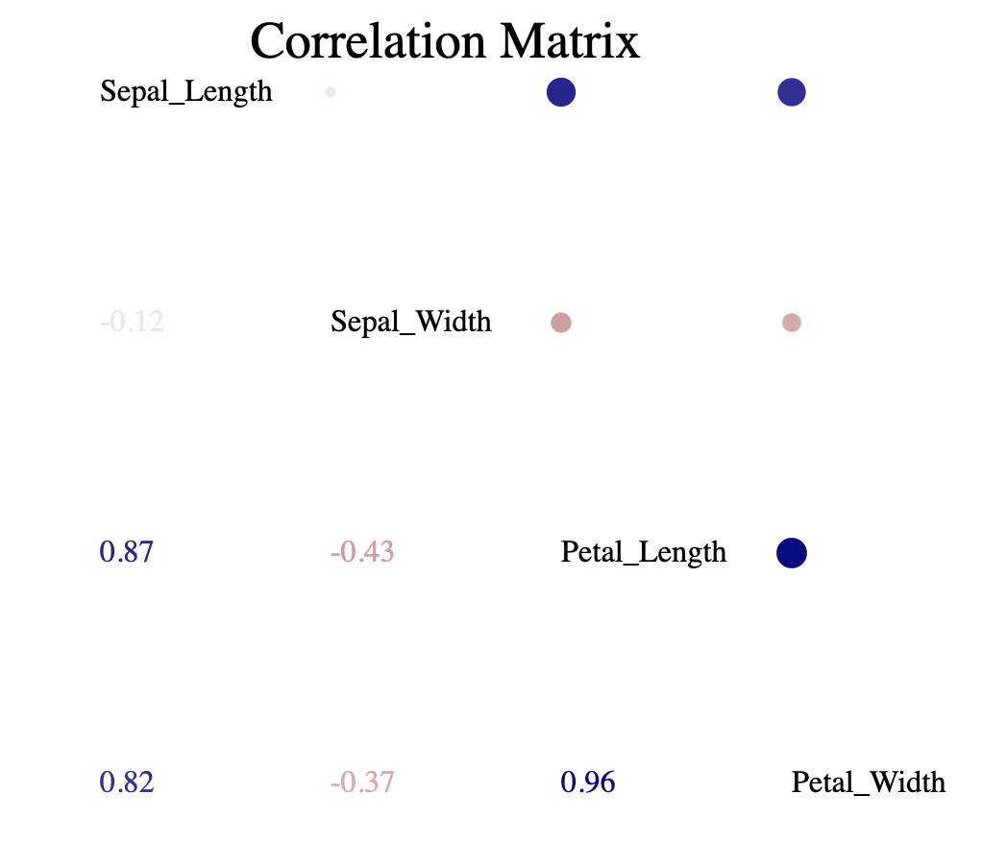
Correlation Matrix Plot
Source HTML file: CorrelationPlot.html

Slide 9
Histograms
Visualization#4

Slide 10
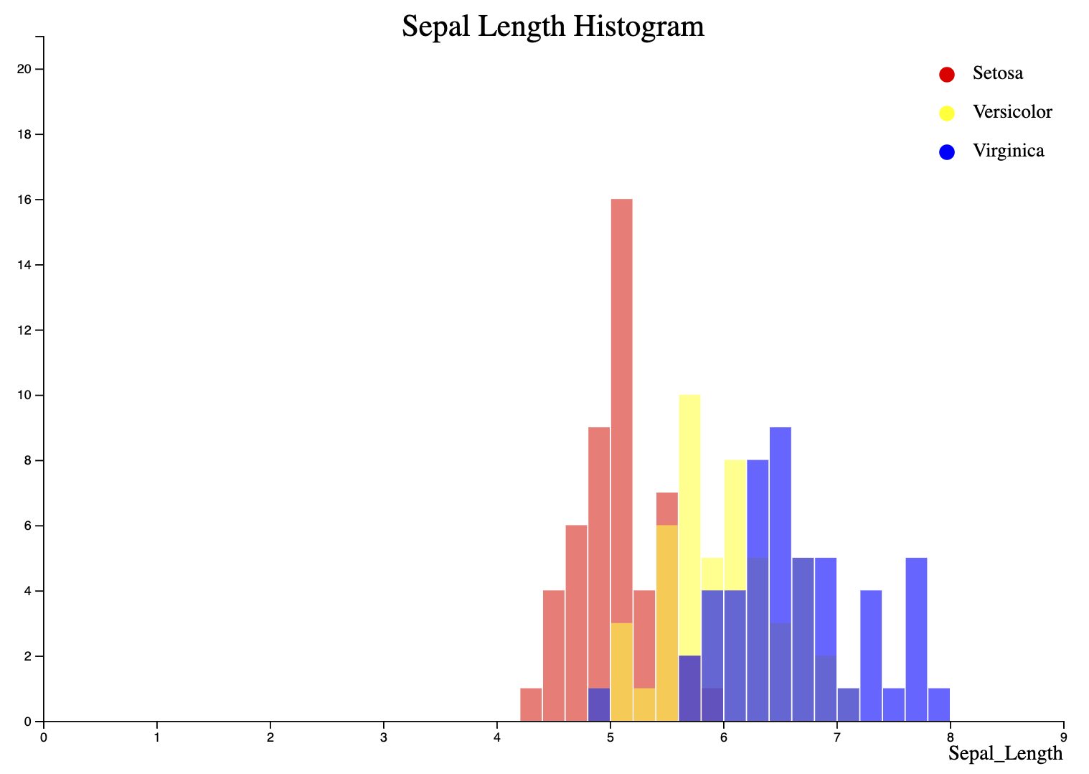
Sepal Length Histogram
Source HTML file: Histograms/SL_Histogram.html

Slide 11
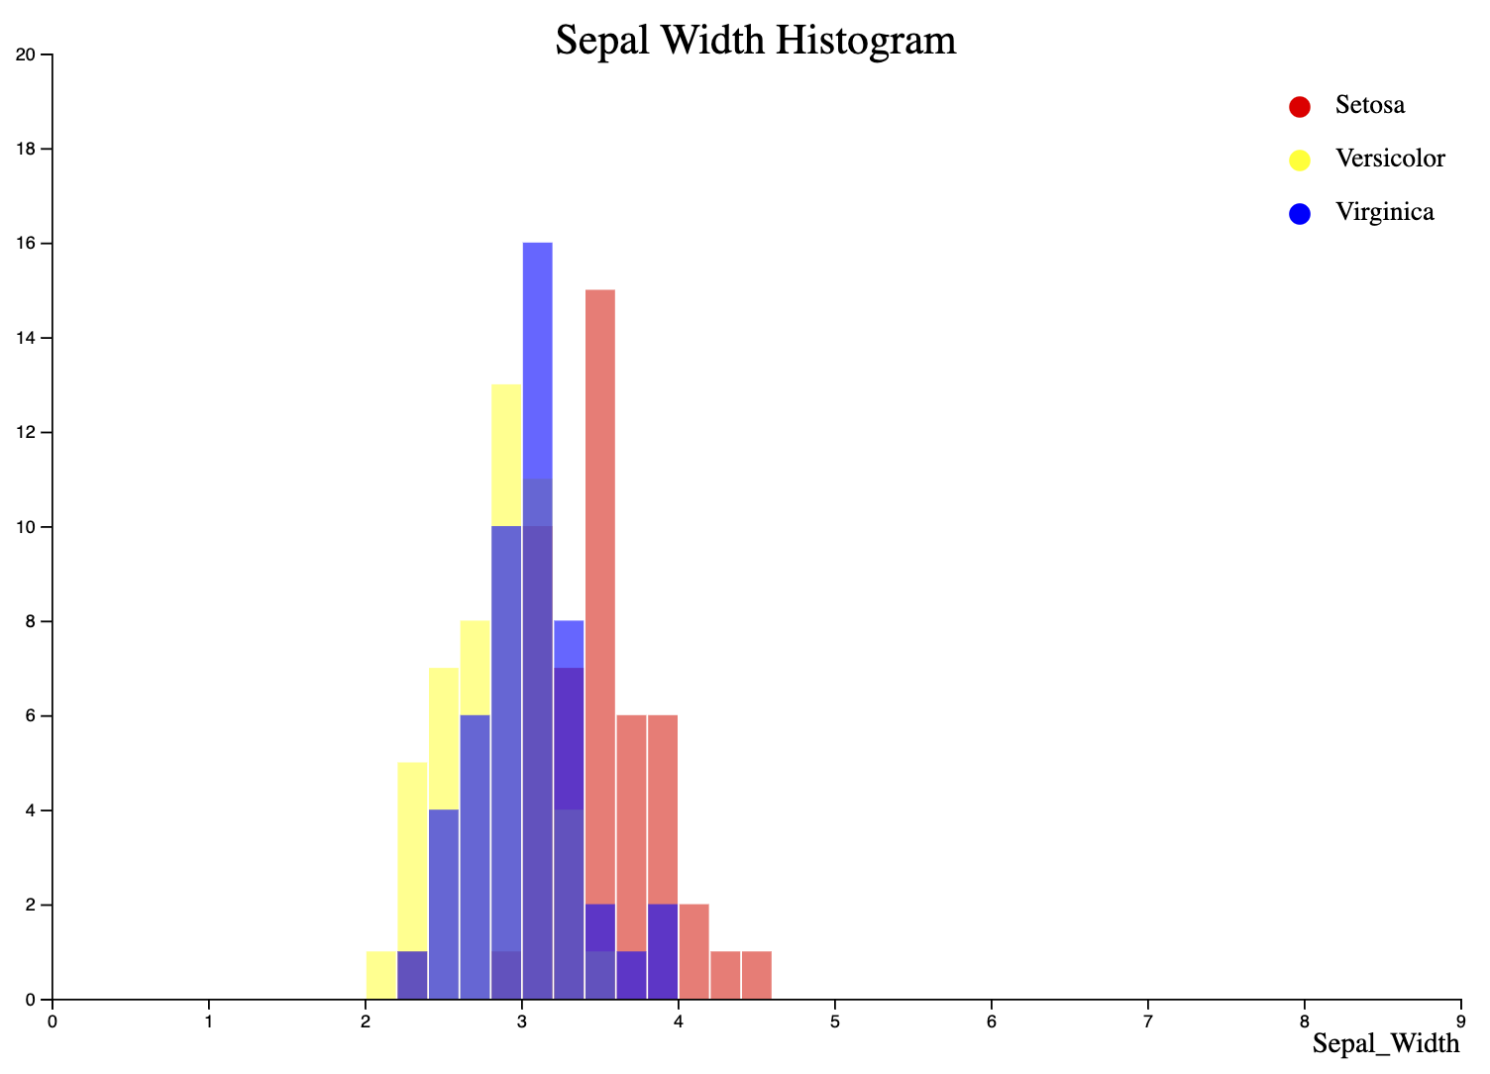
Sepal Width Histogram
Source HTML file: Histograms/SW_Histogram.html

Slide 12
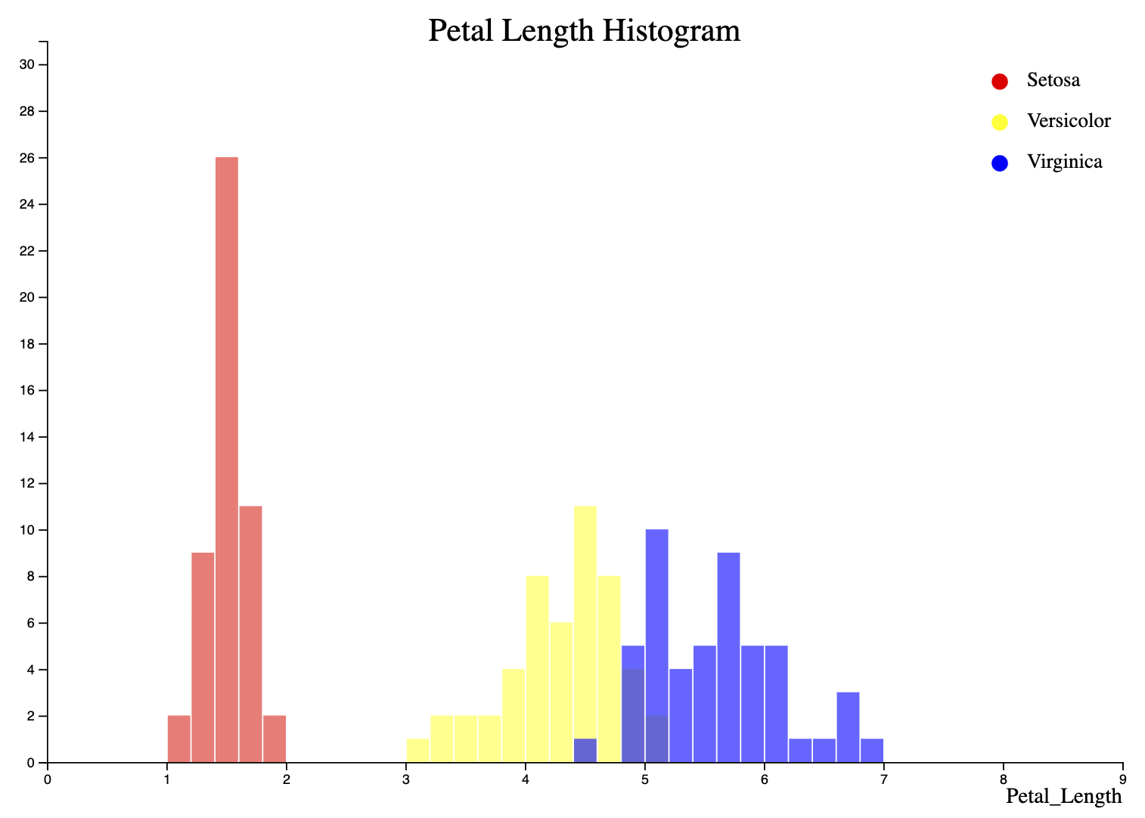
Petal Length Histogram
Source HTML file: Histograms/PL_Histogram.html

Slide 13
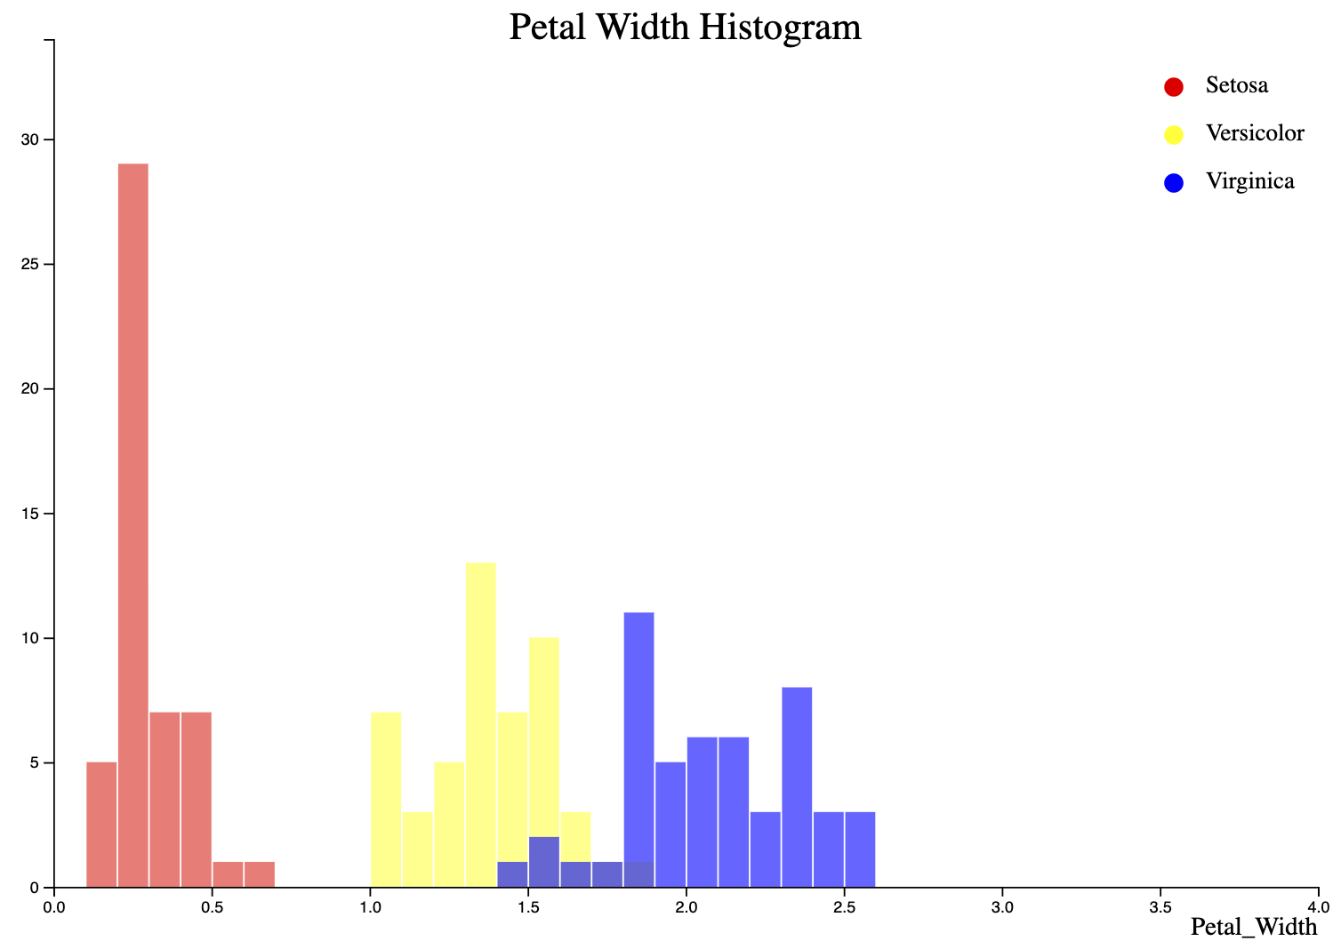
Petal Width Histogram
Source HTML file: Histograms/PW_Histogram.html

Slide 14
Boxplots
Visualization#5

Slide 15
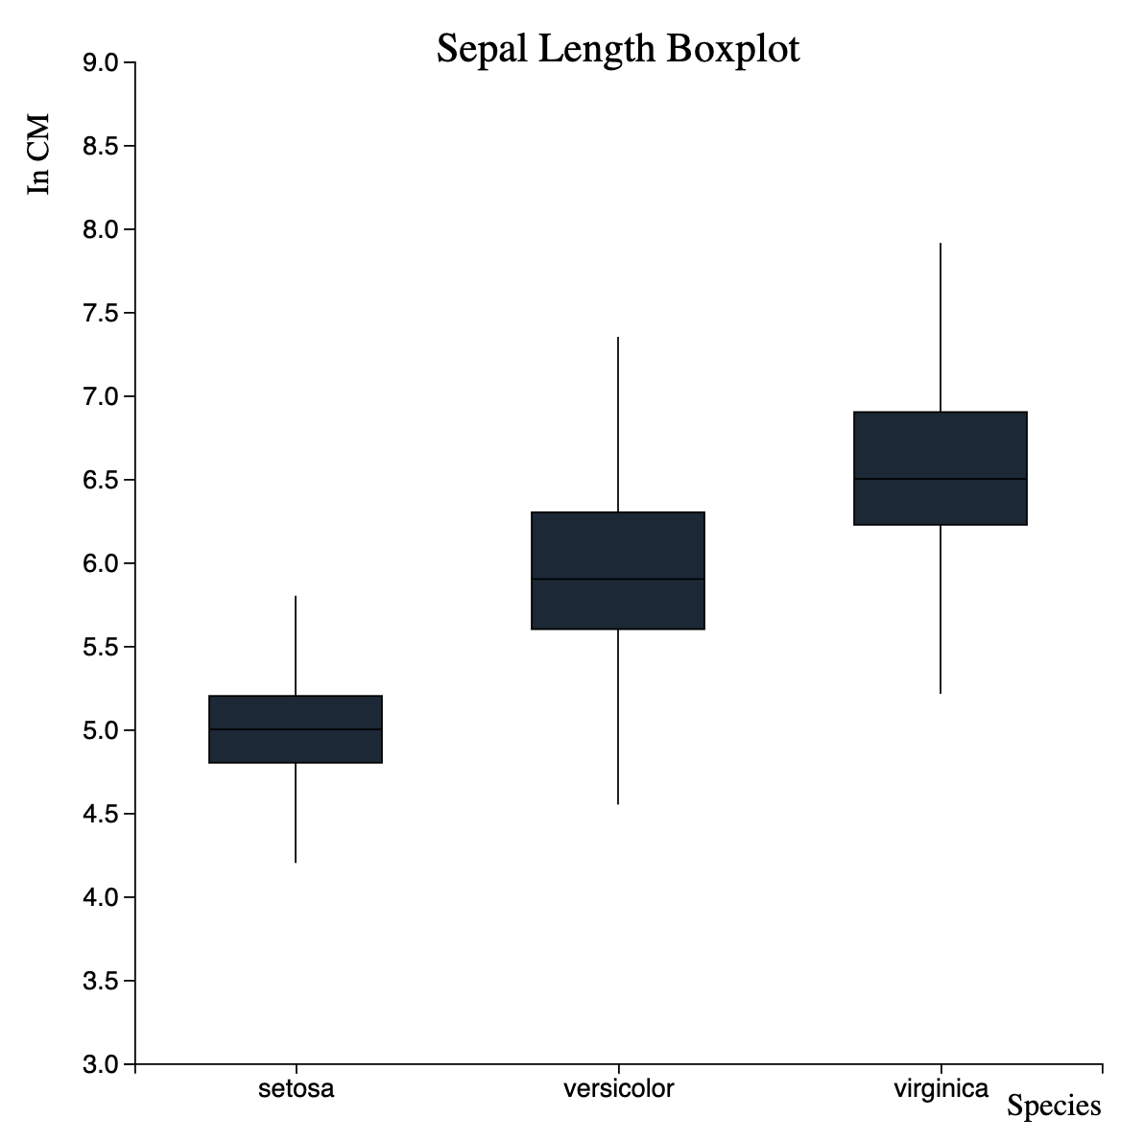
Sepal Length Boxplot
Source HTML file: Boxplots/Boxplot_SL.html

Slide 16
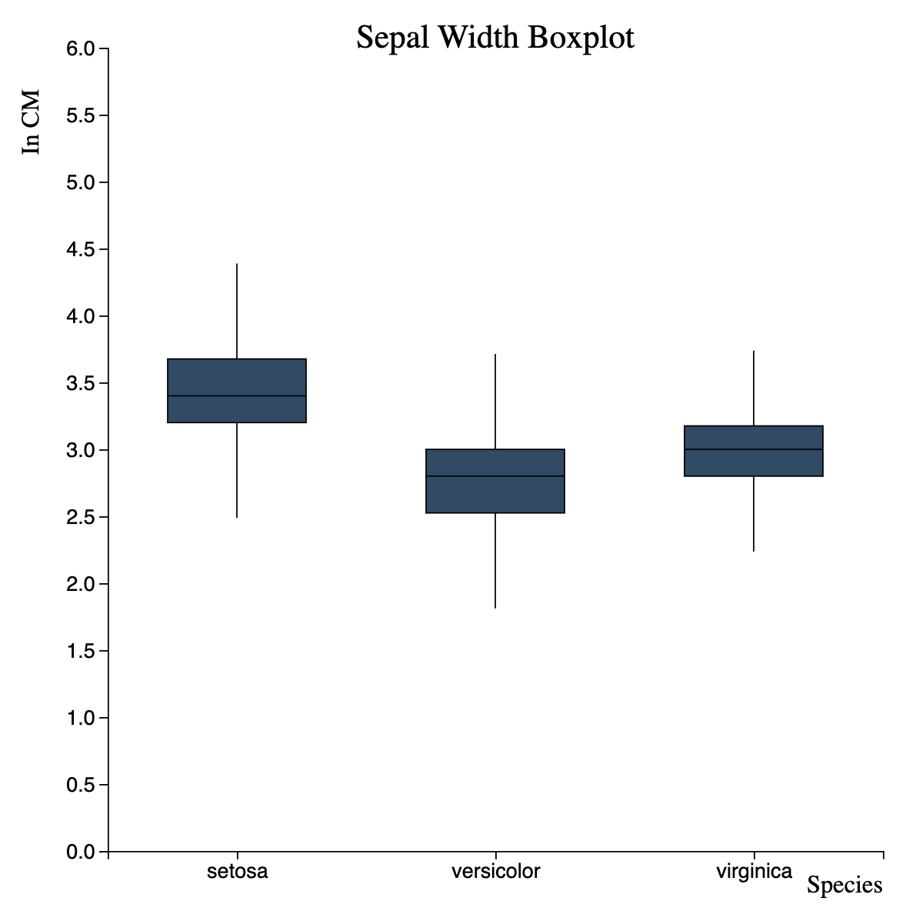
Sepal Width Boxplot
Source HTML file: Boxplots/Boxplot_SW.html

Slide 17
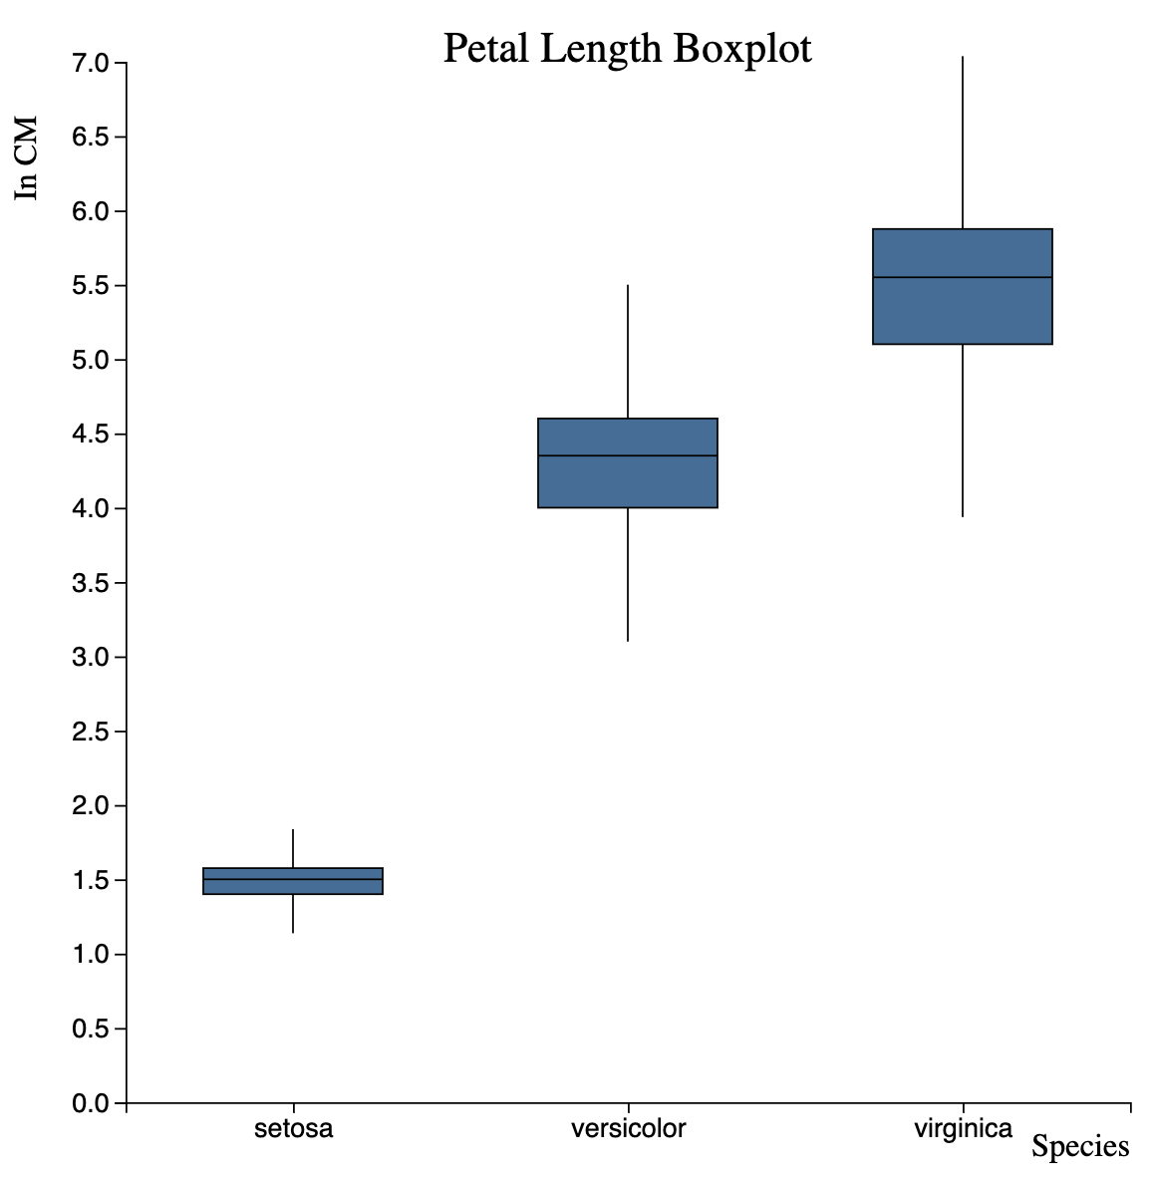
Petal Length Boxplot
Source HTML file: Boxplots/Boxplot_PL.html

Slide 18
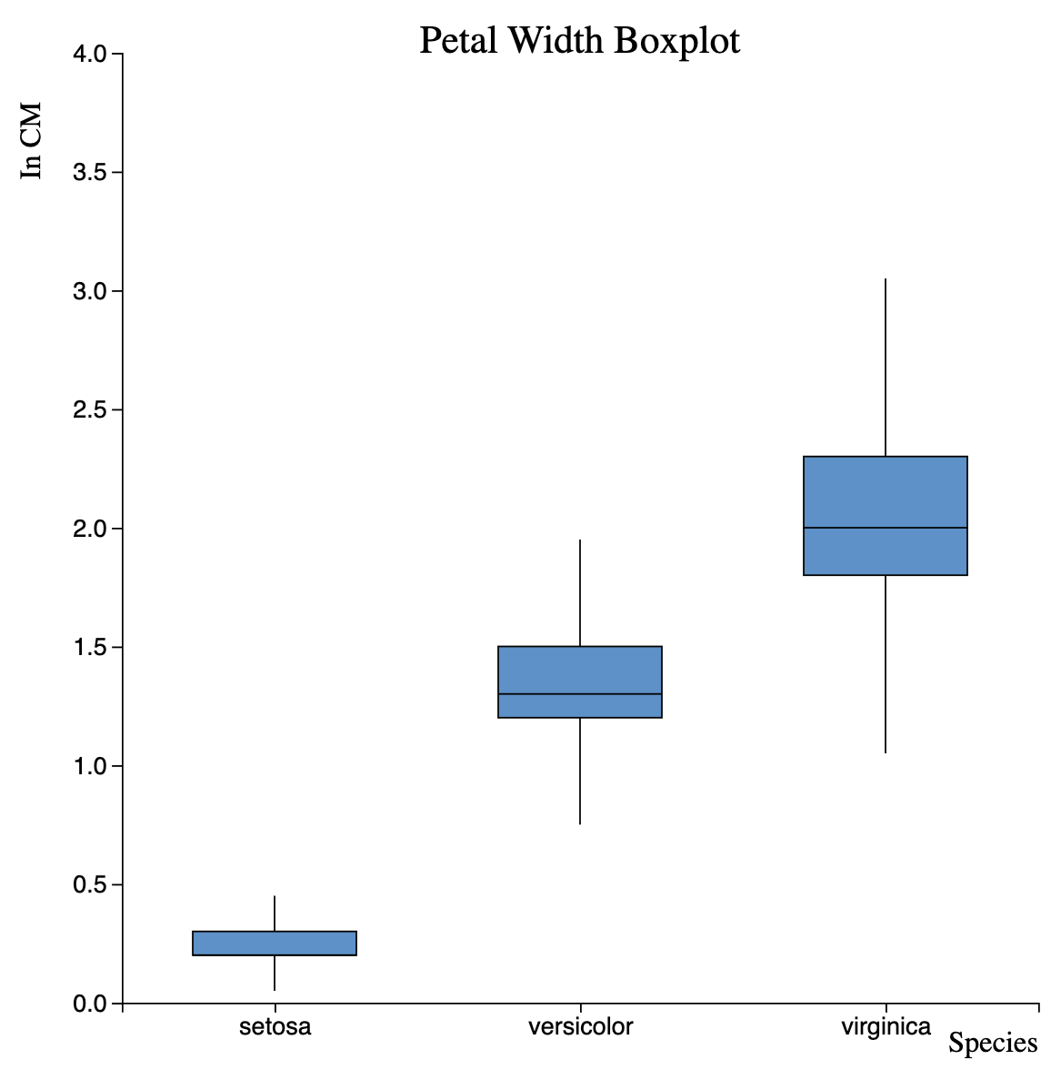
Petal Width Boxplot
Source HTML file: Boxplots/Boxplot_PW.html

Slide 19
Scatterplots Interactive Videos
Visualization#6

Slide 20
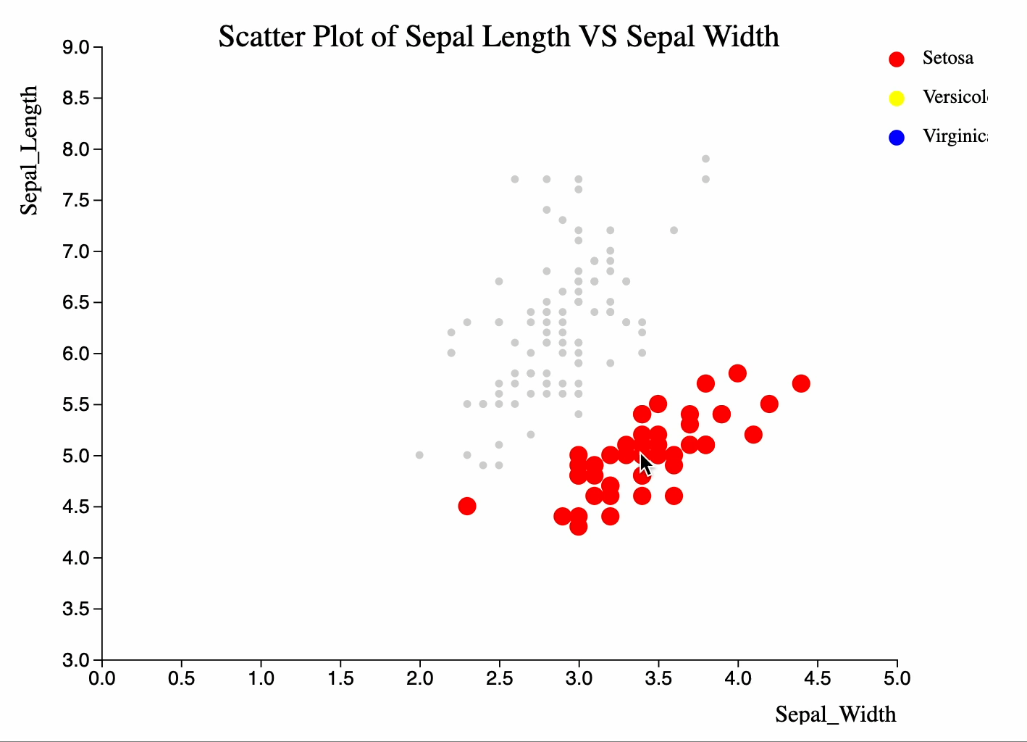
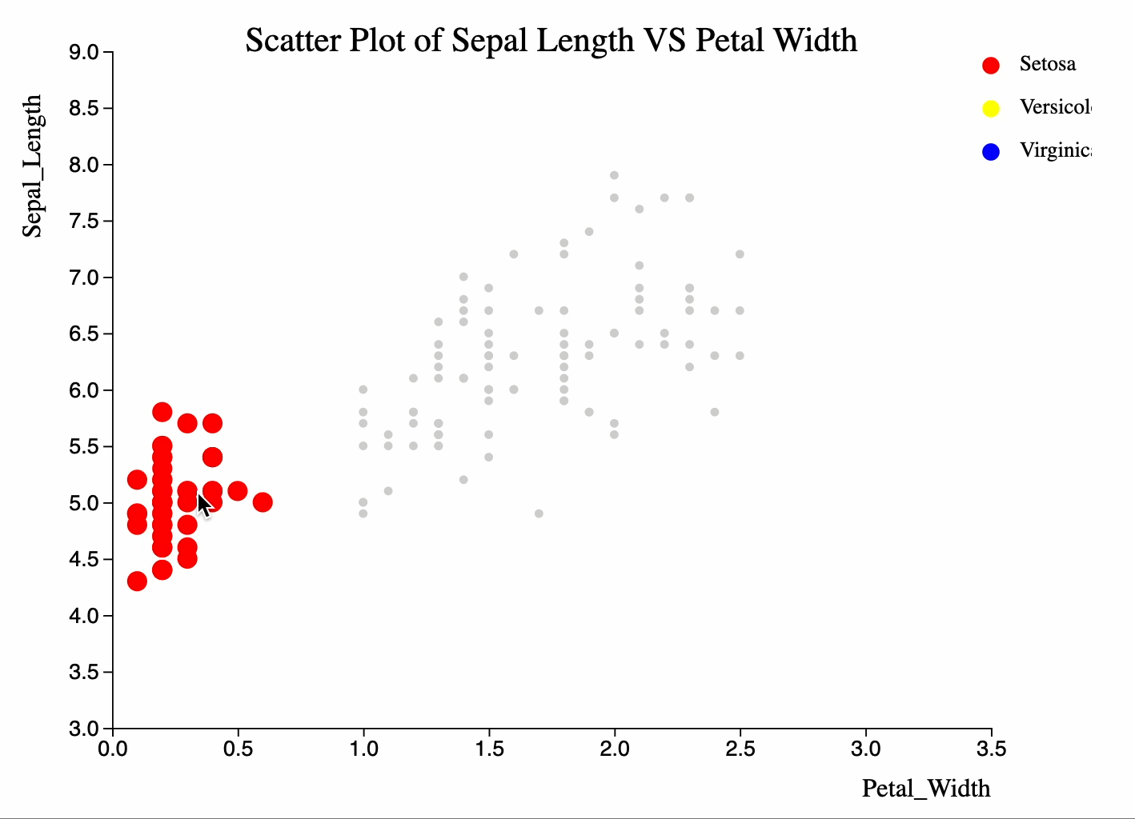
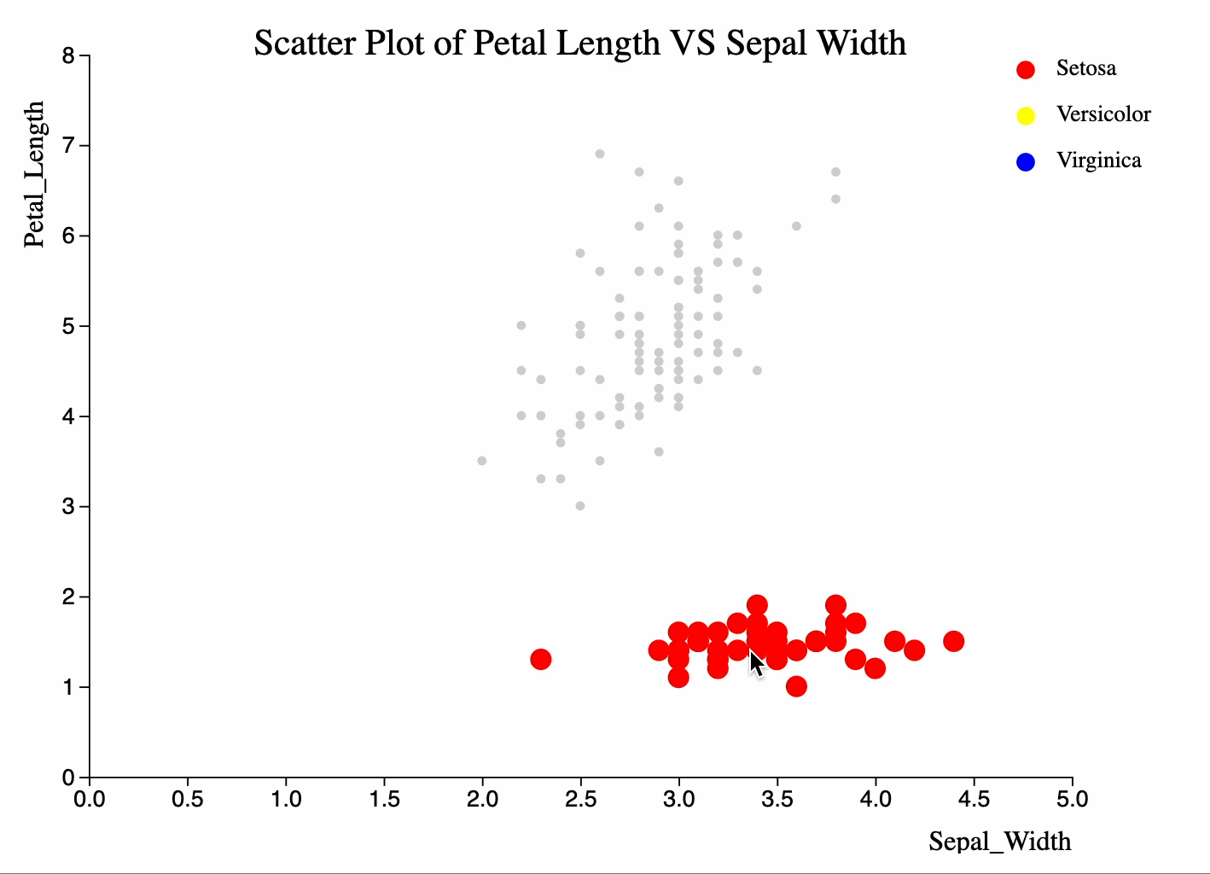
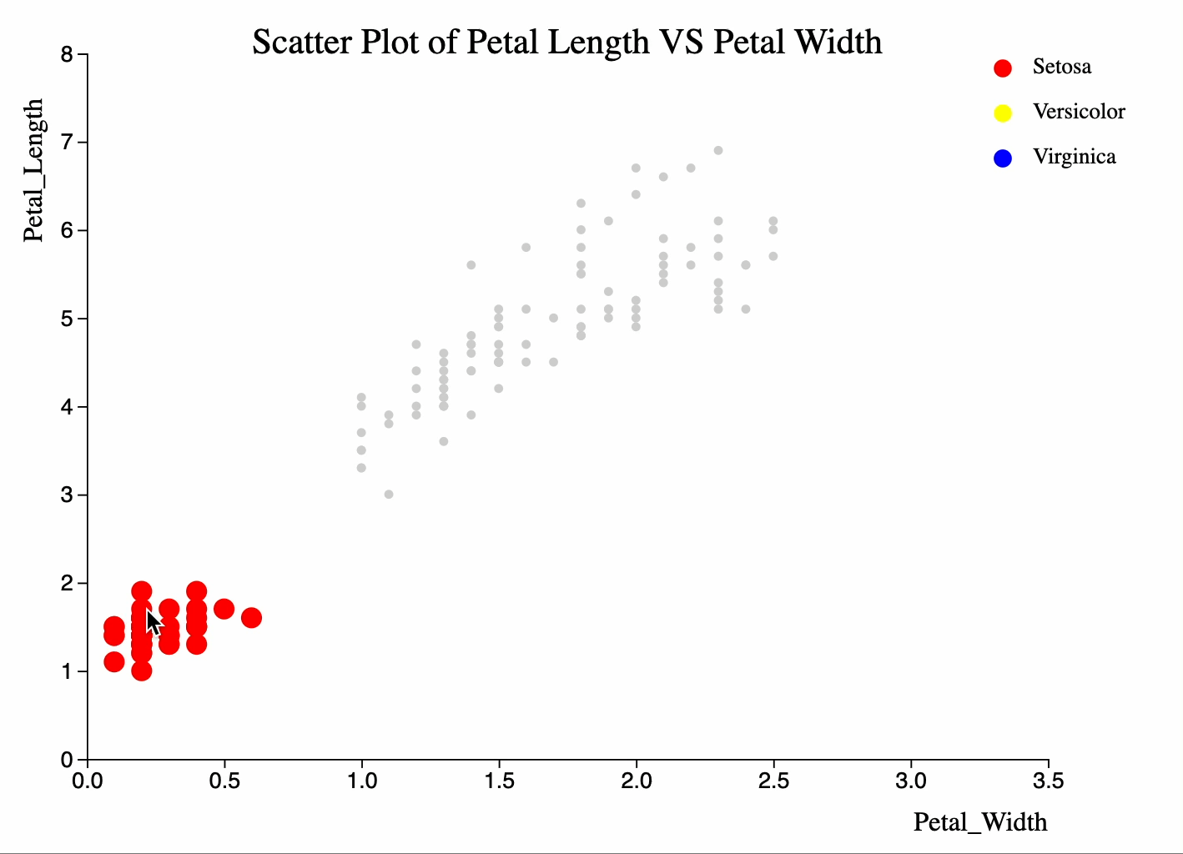
Scatterplots[Interactive Videos]
Source HTML file: Scatterplots/scatterplot_SLvsSW.html
Source HTML file: Scatterplots/scatterplot_SLvsPW.html
Source HTML file: Scatterplots/scatterplot_PLvsSW.html
Source HTML file: Scatterplots/scatterplot_PLvsPW.html

Slide 21
References
https://d3js.org/
https://d3-graph-gallery.com/graph/boxplot_several_groups.html
https://d3-graph-gallery.com/graph/correlogram_basic.html
https://d3-graph-gallery.com/graph/correlogram_scatter.html
https://d3-graph-gallery.com/graph/histogram_double.html
https://d3-graph-gallery.com/graph/custom_theme.html

